Slide 1

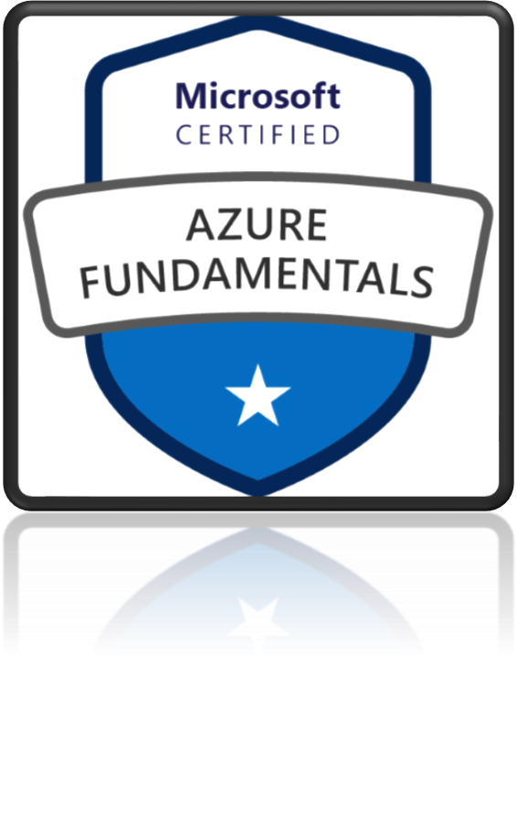
AZ-900
Microsoft Azure Fundamentals

Slide 2
Shared responsibility Model
Who owns the workload responsibility?

Slide 3
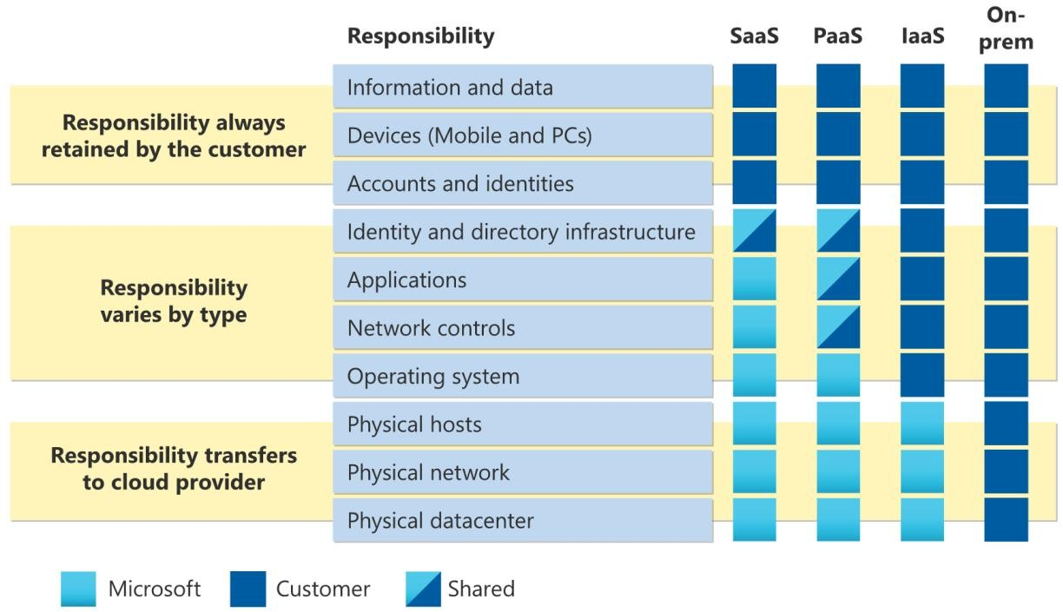
Shared responsibility in the cloud
Workload responsibilities vary depending on whether the workload is hosted on SaaS, PaaS, IaaS or on-premises datacenter
https://docs.microsoft.com/en-us/azure/security/fundamentals/shared-responsibility

Slide 4
Deployment Models
Types of Cloud Computing - Public, Private and Hybrid

Slide 5
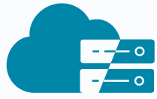


Cloud Deployment Models
VS.
VS.
Hybrid Cloud
Private Cloud
Public Cloud

Slide 6
Public Cloud
Private Cloud
Hybrid Cloud
Cloud resources are those that are owned and managed by a third-party cloud service provider and are provided through the Internet.
Cloud services that are utilized by a particular organization and are not accessible to the general public.
Combination of public and private cloud with automation and orchestration between the two
Advantages
Advantages: Use your own equipment to meet security, compliance, or legacy scenarios
Advantages
No Legal obligation
Control
Strict security and compliance
No Maintenance
Near unlimited scalability
High reliability
Disadvantages
Disadvantages
Expensive
Complicated
Disadvantages
Less control
Use case scenario
Infrastructure cost
Difficult to elasticity
IT Skills
Use case scenario
Medical data can’t expose to
public.
Application runs on old hardware.
Deploy website quickly
Focus on development
Use case scenario
Government policy requires specific data to be kept in- country

Slide 7
Cloud Pricing Models
Factors that affect cost

Slide 8
Cloud Pricing Models
Traditional Data Center Cost
Cloud Computing Cost
Upfront Hardware cost
Can we save money?
Yes, but It’s not straight forward
Bill could depends on multiple metrics for each service
Building, electricity, cooling, Internet
Employees to maintain infrastructure
➢
Software/Application licenses
Example: “Storage Service” pricing depends on:
Volume of data stored per month.
Quantity and types of operations performed
Data transfer costs.
Data redundancy/backups
And so on…
Example “VM” Pricing depends on:
Overall CPU time
Time spent with a public IP address
Incoming (ingress) and outgoing (egress) network traffic in and out of the VM
Disk size and amount of disk read and disk write operations
➢
60

Slide 9
Cloud Pricing Models
Virtual Network
Azure Policy
Azure Active Directory
Azure Migrate
Always FREE
Azure Open Datasets
Azure Lighthouse
Azure Private Link
Azure Data Catalog
Azure Service Fabric
61

Slide 10
Cloud Pricing Models
Charge based on time you use a particular service
Other imp parameters like performance tiers and other configurations
Examples:
Virtual Machine
App Services
SQL Database
Load Balancer
Pay: Time
62

Slide 11
Cloud Pricing Models
Database Storage
Pay: GB
Storage Service
Network traffic (between regions)
63

Slide 12
Cloud Pricing Models
Charges based on number of operation
Pay: Operations
Example: Cost per million operation
Storage services (read, write or delete operations)
Cosmos DB
64

Slide 13
Cloud Pricing Models
Serverless offerings
Pay: Execution
Charges only when you use, per execution
Azure Function
Serverless Database
Logic Apps
65

Slide 14
Cloud Pricing Models
Example: Azure Active Directory Premium tier
Pay: Other metrics
Charge based on number of user licenses
66

Slide 15
Cloud Pricing Models
Regions/Locations
How you purchase service
Through an Enterprise Agreement
Directly from the web
Through a Cloud Solution Provider Support options
Other Parameters
➢
Programs and offers
And so on….
67

Slide 16
Benefits of Cloud Computing
High availability: Provide a continuous user experience with no apparent downtime
Scalability: Apps in the cloud can scale vertically and horizontally:
Vertically expand a virtual machine's computing capability by adding RAM or CPUs.
Horizontal scaling improves computing capacity by increasing instances of resources, such as VMs.
Elasticity: Cloud-based applications may be configured to use autoscaling, ensuring they always have enough resources. Agility: Rapidly deploy and configure cloud resources as your app's needs change.
Geo-distribution: Global geo-distribution of applications and data ensures that consumers get the optimum performance in their area.
Disaster recovery: Cloud-based backup services, data replication, and geo-distribution allow you to deploy applications with assurance that your data will be secure in the event of a disaster.
68

Slide 17
High availability, Fault tolerance and Disaster recovery
Scalability, Elasticity, and Agility
CapEx vs OpEx
Capital Expenditure (CapEx) - Upfront cost
Operational Expenditure (OpEx) - Pay-as-you-go pricing Economic benefits of the cloud
Learning Outcome
➢
Consumption-based model
Computing Models - Categories of cloud services
Software as a service (SaaS)
Platform as a service (PaaS)
Infrastructure as a service (IaaS) Deployment Models
Types of Cloud Computing - Public, Private and Hybrid
Cloud Pricing Model
➢

Slide 18
Azure Architectural Components
In this module, you'll learn about several of the components that are necessary to successfully deploy resources on Azure.
Data Centers, Regions, Region pairs
Availability Zones
Learning Objectives
Resource Groups
Azure Resource Manager (ARM)
Subscription
Management Groups

Slide 19
Azure Global Infrastructure
Data Centers, Regions, Region pairs

Slide 20
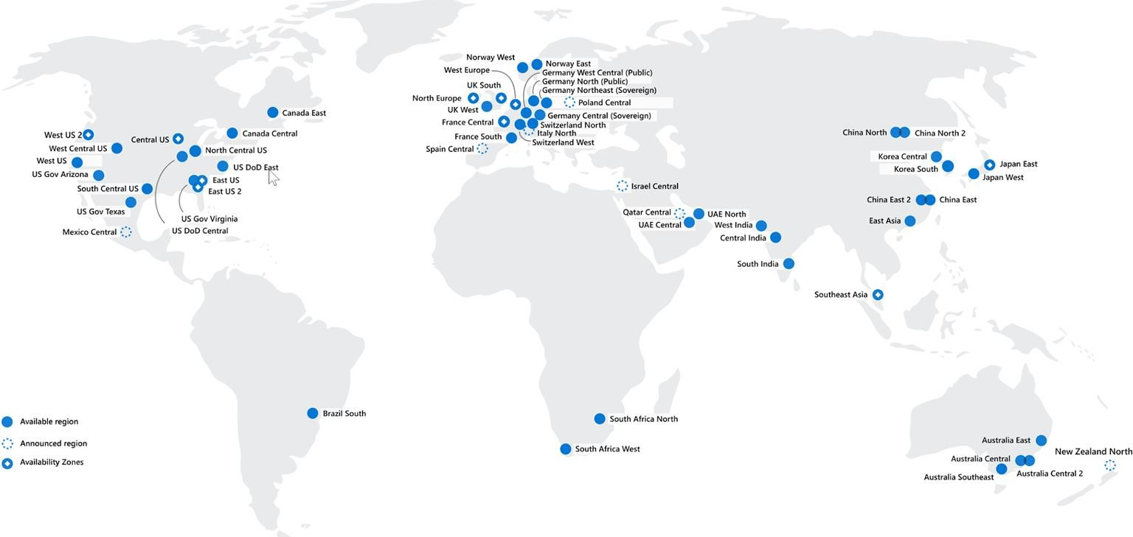
Regions
Region, which is a physical location around the world where we cluster data centers.
Azure has more global regions than any other cloud provider.
Better scalability and redundancy
Preserve data residency
Low Latency
Global Footprint
High Availability
How to choose region?
Compliance
Proximity
Available services
Pricing

Slide 21
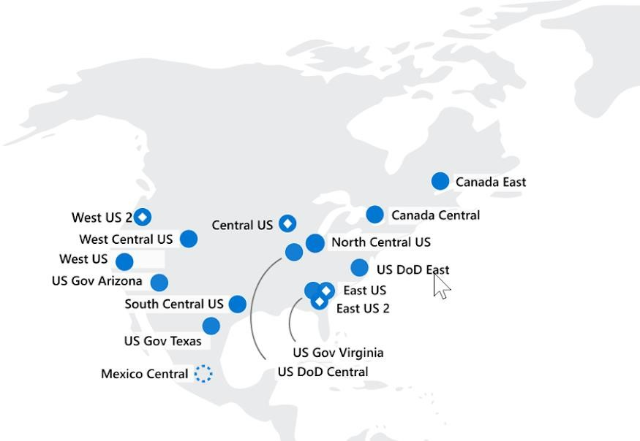
Azure region pairs
Each Azure region is always paired with another region within the same geography
Data centers are usually 300+ miles apart
Automatic replication and failover for some azure services.
Additional advantages of region pairs:
If an extensive Azure outage occurs, one region out of every pair is prioritized to make sure at least one is restored as quickly as possible for applications hosted in that region pair.
Planned Azure updates are rolled out to paired regions one
region at a time to minimize downtime and risk of application outage.
Data continues to reside within the same geography as its pair.

Slide 22
Azure Global Infrastructure
Availability Zones

Slide 23
Regions

Slide 24
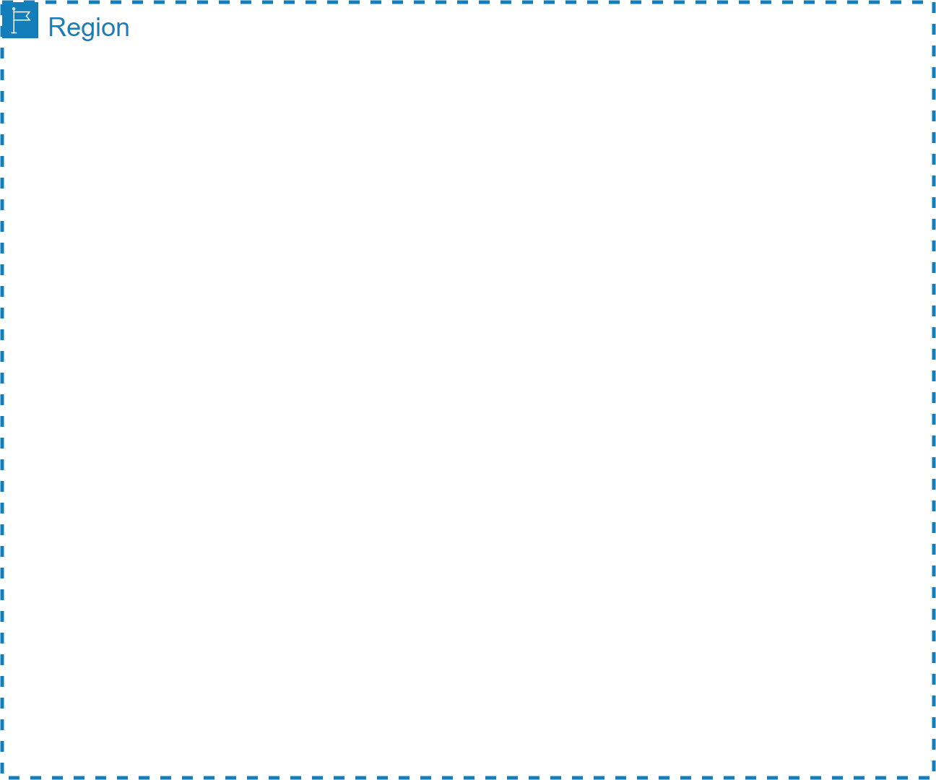
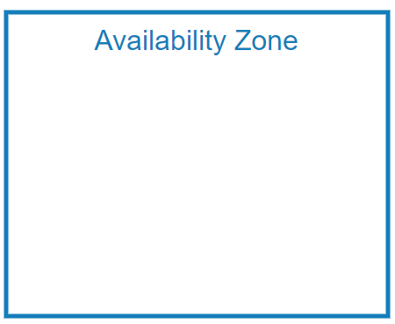



Availability Zones
Region represents a separate geographic area.
Availability zone is a set of discrete data centers.
Availability zone is set up to be an isolation boundary. If one zone goes down, the other continues working.
Each availability zone has independent power, cooling and networking.
Availability zones are connected via high bandwidth, ultra-low latency networking
AZs are physically separated by several kilometers, while being within 100 km (60 miles) of one each.
High-speed, private
fiber-optic networks
All AZ traffic is encrypted.
Not every region has support for availability zones.

Slide 25
Resource Groups
Logical container for resources

